Slide 1
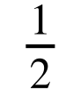
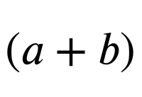
Problem solving with expressions and formulae
Task A: Forming expressions for area
Here are some formula for the area of 2D shapes which may help you with the following task.
a
l
b
h
w
h
b
area = width × length
area = × base × height
area = × × height
Where a and b are the parallel sides.
1) Write a sentence explaining why the area of this shape can be written in each of the following ways:
a) (x − 4)²
b) (x − 4)(x − 4)
c) x² − 8x + 16
The shape is a square so the area can be found by squaring one side length.
x − 4
Squaring an expression is the same as multiplying that expression by itself. (x − 4)² ≡ (x − 4)(x − 4)
We can multiply the binomials using the distributive law: (x − 4)(x − 4) ≡ x(x − 4) − 4(x − 4) ≡ x² − 4x − 4x + 16 ≡ x² − 8x + 16
2) Draw a rectangle with an area of (6 + y)(2 + y) write a different expression for the area of your rectangle.
6 + y
(y + 6)(y + 2) or equivalent binomials.
2 + y
y² + 2y + 6y + 12
y² + 8y + 12

Slide 2
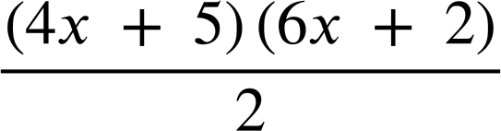
Problem solving with expressions and formulae
(4x + 5)(6x + 2)
3a) Explain why the area of this shape be written as
The area of a triangle can be calculated by multiplying the base by the height and multiplying by a half.
b) Write the expression for the area of this shape in two different ways.
6x + 2
E.g.
(4x + 5)(3x + 1)
(2x + 2.5)(6x + 2)
4x + 5
12x² + 4x + 15x + 5
12x² + 19x + 5
c) Draw and label a triangle with area (x + 1)(3x − 2)
6x − 4
or
2x + 2
x + 1
3x − 2
The binomials can be on either dimension.
4) Match these shapes to the correct expression for their area.
a
b
2x + 2
c
d
x + 2
x + 1
x + 2
x + 1
4x − 4
4x − 4
4x − 4
2x − 2
(4x − 4)(x + 2)
(6x − 2)(x + 1)
(4x − 4)(x + 2)
(2x − 2)(x + 1)
(2x − 2)(x + 2)
(3x − 1)(x + 1)
4x²+ 8x − 4x − 8
(x − 1)(x + 1)
2x²+ 4x − 2x − 4
3x²+ 3x − x − 1
x²+ x − x − 1
e
x² − 1
f
2x²+ 2x − 4
g
3x²+ 2x − 1
h
4x²+ 4x − 8

Slide 3
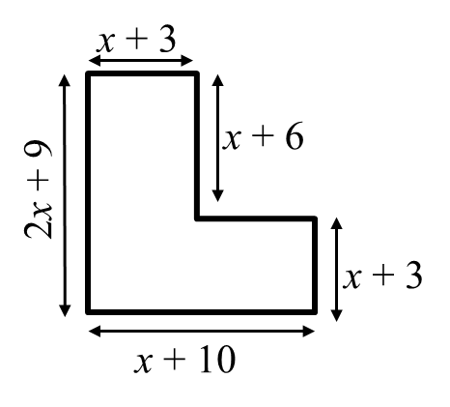
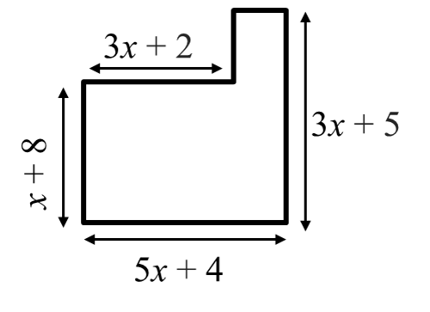
Problem solving with expressions and formulae
Task B: Area of compound shapes
1) Calculate a simplified expression for the area of this shape.
2) Calculate a simplified expression for the area of this shape.
5x + 4 − (3x + 2)
2x + 2
(x + 10)(x + 3) + (x + 6)(x + 3)
(3x + 2)(x + 8) + (2x + 2)(3x + 5)
(x² + 13x + 30) + (x² + 9x + 18)
(3x² + 24x + 2x + 16) + (6x² + 10x + 6x + 10)
2x² + 22x + 48
(3x² + 26x + 16) + (6x² + 16x + 10)
9x² + 42x + 26
3a) Calculate a simplified expression for the area of the shaded shape.
(x + 12)(x + 7) − (x − 2)(x − 2)
x + 7
(x² + 7x +12x + 84) − (x² − 2x − 2x + 4)
x − 2
x − 2
(x² + 19x + 84) − (x² − 4x + 4)
23x + 80
x + 12
b) The area of the shaded shape is 149 square units. Use this to find the value of x
23x + 80 | = | 149
23x + 80 − 80 | = | 149 − 80
23x | = | 69
x | = | 3

Slide 4
Problem solving with expressions and formulae
4a) Calculate a simplified expression for the area of the shaded shape.
(6x − 9)(2x + 7) − 3x(4x − 1)
3x
(12x² + 42x − 18x − 63) − (12x² − 3x)
4x − 1
2x + 7
(12x² + 24x − 63) − (12x² − 3x)
27x − 63
6x − 9
b) The area of the shaded shape is 99 square units. Use this to find the value of x
27x − 63 | = | 99
(27x − 63) ÷ 9 | = | 99 ÷ 9
3x − 7 | = | 11
3x − 7 + 7 | = | 11 + 7
3x | = | 18
x | = | 6
5) Four identical rectangles sit round the outside of a shaded square.
a) Find a simplified expression for the area of one rectangle.
b) Find a simplified expression for the area of the whole shape.
c) Find a simplified expression for the area of the shaded square.
2x + 3
(2x + 3)(x + 2) ≡ 2x² + 4x + 3x + 6
≡ 2x² + 7x + 6
2x + 3 + x + 2 ≡ 3x + 5
x + 2
(3x + 5)² ≡ 9x² + 30x + 25
4(2x² + 7x + 6) ≡ 8x² + 28x + 24
or
2x + 3 − (x + 2) ≡ x + 1
9x² + 30x + 25 − (8x² + 28x + 24) ≡ x² + 2x + 1
(x + 1)² ≡ x² + 2x + 1
Mathematics in Education and Industry
v2.3

